Slide 1
Final Project
Name : Sree Rag G.S
Reg no : 962821104091
Nm id : au962821104091
Dept : Computer Science and Engineering
College : University College of Engineering,Nagercoil
Email : sreeraggs2931@gmail.com
3/21/2024 Annual Review

Slide 2
PROJECT TITLE: Fake News Classifier using LSTM
3/21/2024 Annual Review

Slide 3


AGENDA
Introduction
Problem statement
Project review
Solution and value proposition
The wow in our solution
Modelling
Results
Conclusion
3/21/2024 Annual Review

Slide 4
INTRODUCTION
With the proliferation of social media and online platforms, the spread of misinformation and fake news has become a significant challenge in today's digital age.
Fake news, characterized by false or misleading information presented as factual news, can have far-reaching consequences, including influencing public opinion, shaping political discourse, and undermining trust in traditional media sources..

Slide 5

PROBLEM STATEMENT
The project addresses the challenge of developing a LSTM Model for classification of the fake news.
In response to this growing misleading false information problem, there is a pressing need for effective techniques to identify and classify fake news articles automatically.
3/21/2024 Annual Review

Slide 6

PROJECT OVERVIEW
In today's digital age, the spread of misinformation and fake news has become a significant concern.
With the abundance of online content, distinguishing between genuine and fabricated information has become increasingly challenging.
To address this issue, our project aims to develop a Fake News Classifier using Generative AI.
3/21/2024 Annual Review

Slide 7
WHO ARE THE END USERS?
Social Media Platforms: Social media platforms such as Facebook, Twitter, and Instagram can utilize the fake news classification system to identify misleading or false information shared by users on their platforms.
News Media Organizations: News media organizations can leverage the fake news classification system to verify the authenticity of news articles and sources before publishing or sharing them with their audience.
Government Agencies: Government agencies can deploy the fake news classification system to identify and address instances of misinformation and disinformation campaigns aimed at manipulating public opinion .
3/21/2024 Annual Review

Slide 8

YOUR SOLUTION AND ITS VALUE PROPOSITION
We develop a LSTM model which contribute to the development of automated tools for combating the spread of misinformation and promoting information integrity in online media platforms.
Enhanced User Experience
Efficient Communication
Scalable and flexible
Insight Generation
VALUE
3/21/2024 Annual Review

Slide 9

THE WOW IN YOUR SOLUTION
Our solution involves harnessing the cutting-edge capabilities of LSTM networks to tackle the pervasive issue of fake news
By leveraging the power of deep learning, we're not just building a classifier – we're creating a tool that can discern truth from fiction in the vast sea of online information
3/21/2024 Annual Review

Slide 10
MODELLING
Steps:
Defining the problem
Data collection and preprocessing
Feature Engineering
Model selection and training
Model Evaluation and Analysis
Deployment
3/21/2024 Annual Review

Slide 11
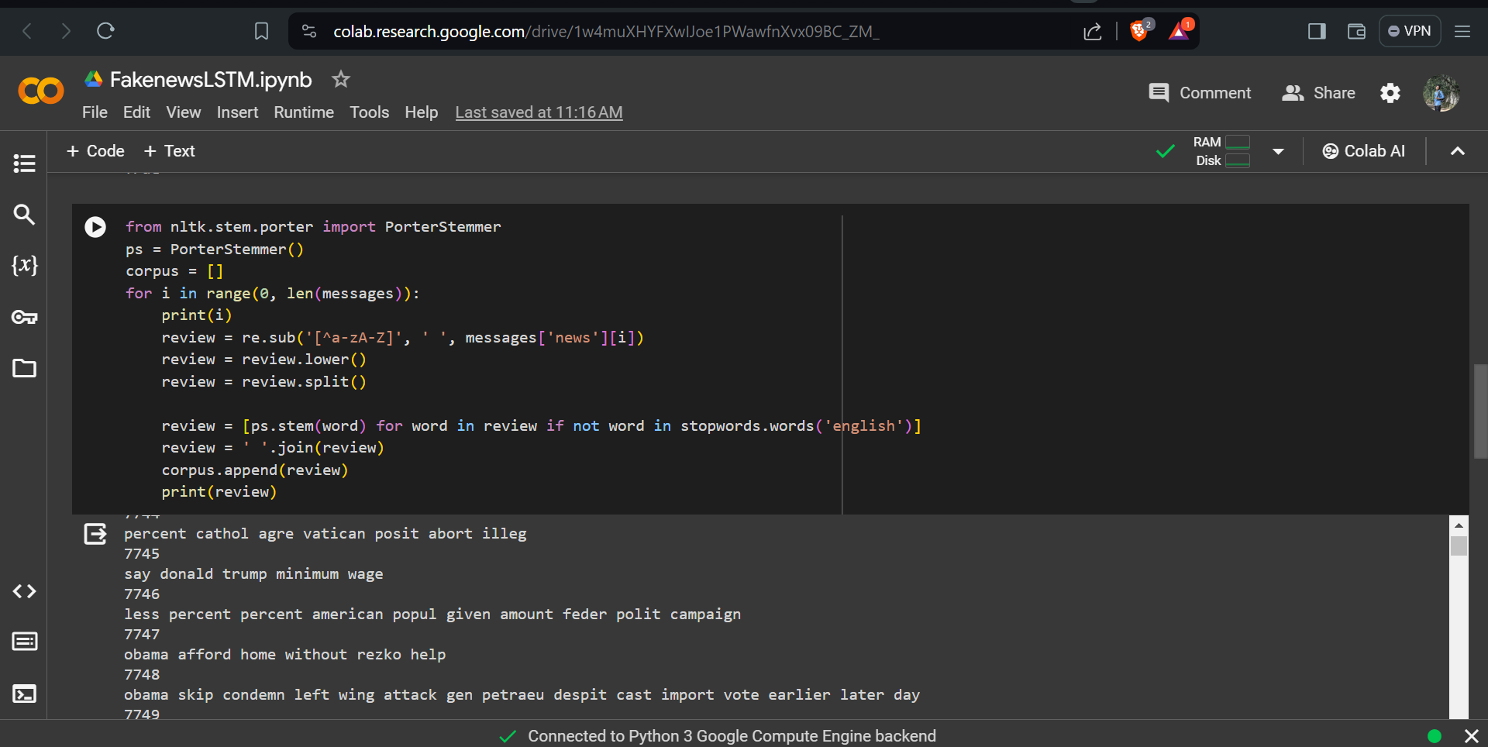
RESULTS

Slide 12
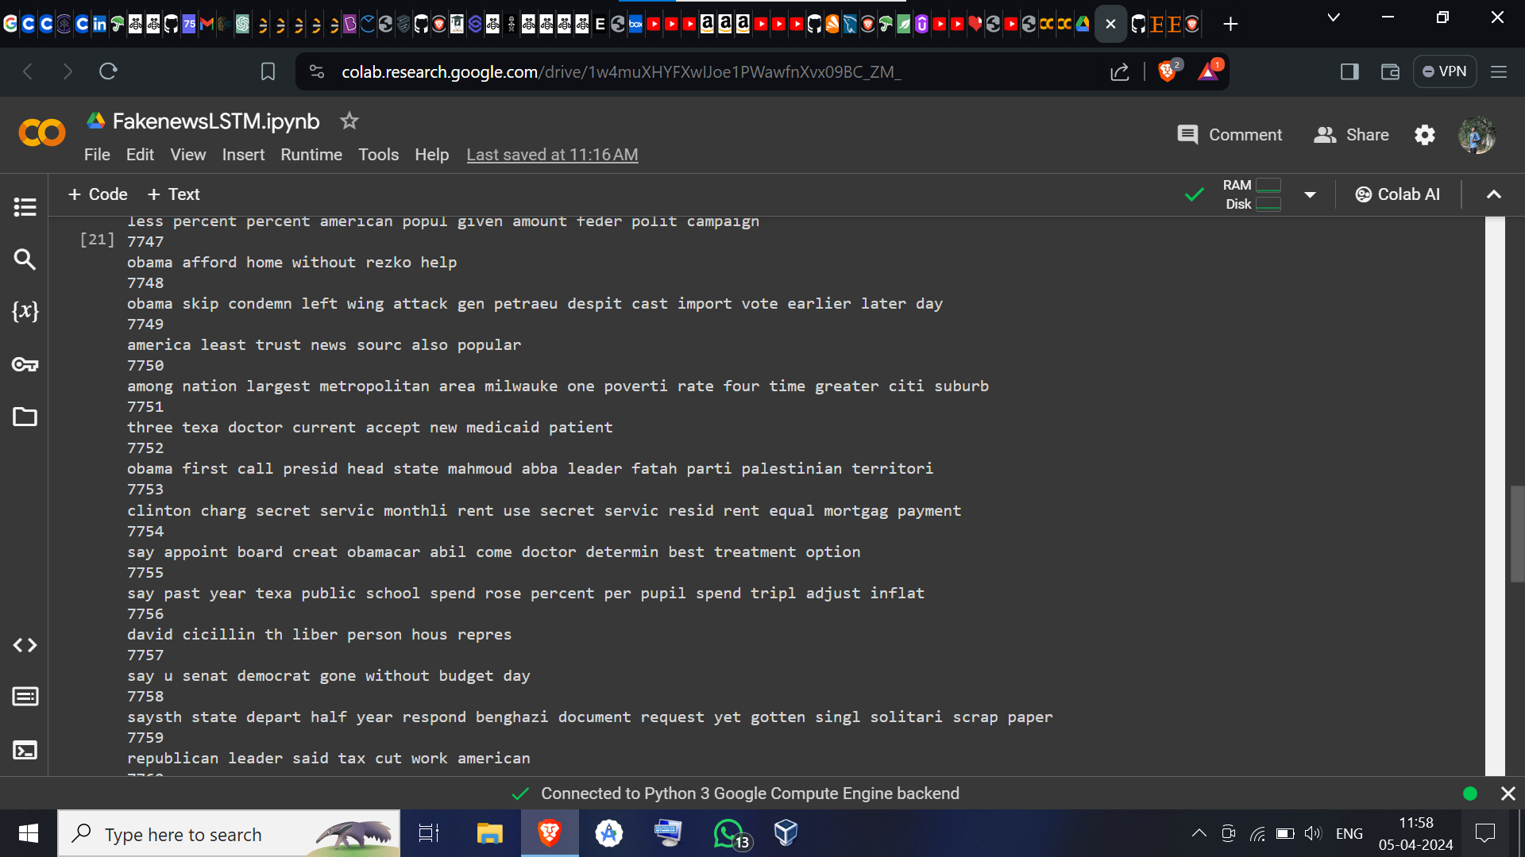

Slide 13
CONCLUSION
The development of a solution for building a fake news classifier is a crucial step in combating misinformation and ensuring information integrity online.
In essence, the fake news classifier represents a proactive effort to promote media literacy and uphold truth in the digital age.
By harnessing technology and data-driven insights, we empower individuals and organizations to make informed decisions and combat the spread of misinformation effectively.
Demo Link
3/21/2024 Annual Review

Slide 14
THANK YOU

